Slide 1
0
Main Menu
1, 2, 3, 5
1
Account Creation
1, 2
2
Appointment Booking
3
3
Virtual Waiting Room
5
4
Account Sign Up Form
1.1 , 2.1
7
Schedule Appointment
3.1
11
Appointment Check In
5.1
5
View Account
8
View Scheduled Appointments
12
Ready Notice
6
Update Account Information
1.3, 2.1.2
9
Update Appointment
3.2
10
Cancel Appointment
3.3

Slide 2
0
Main Menu
1, 2, 3, 5
1
Account Creation
1, 2
2
Appointment Booking
3
3
Virtual Waiting Room
5
4
Account Sign Up Form
1.1 , 2.1
7
Schedule Appointment
3.1
11
Appointment Check In
5.1
5
View Account
8
View Scheduled Appointments
12
Ready Notice
6
Update Account Information
1.3, 2.1.2
9
Update Appointment
3.2
10
Cancel Appointment
3.3

Slide 3
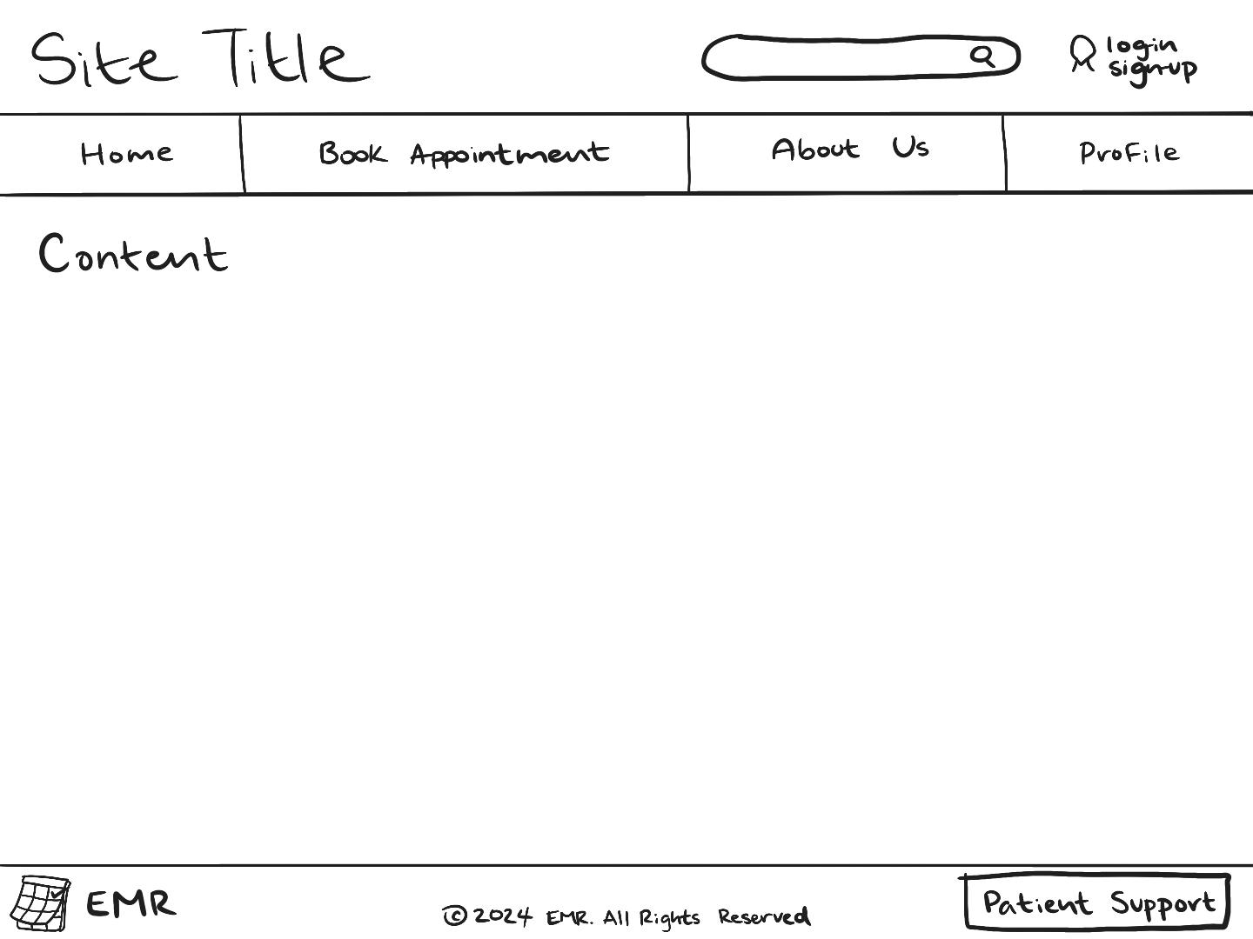
Site Name
Search Bar
Log In
Sign Up
Home
Book Appointment
About Us
Profile
Content
Copyright
Contact Information

Slide 4


. MEDISYNC SOLUTIONS
LOG IN
SIGN UP
Search…
🔍
Home
Book Appointment
About Us
Profile
Streamline your appointment booking with effortless scheduling!!
Check into your appointment
here ⤵
Virtual Waiting Room
Copyright © 2024 MediSync Solutions. All Rights Reserved
Contact Us at (098) 765 - 4321

Slide 5
. MEDISYNC SOLUTIONS
LOG IN
SIGN UP
Search…
🔍
Home
Book Appointment
About Us
Profile
Log In
Email Address
Password
Don’t have an account? Sign Up Here!
Log In
Copyright © 2024 MediSync Solutions. All Rights Reserved
Contact Us at (098) 765 - 4321

Slide 6
. MEDISYNC SOLUTIONS
LOG IN
SIGN UP
Search…
🔍
Home
Book Appointment
About Us
Profile
Sign Up
Fill out each box to create your account.
First Name
Last Name
Date of Birth
Phone Number
MM/DD/YYYY
( _ _ _ ) - _ _ _ - _ _ _ _
Email Address
Mailing Address
Medical History
Password (requires 8+ characters and 1+ numbers)
Already have an account? Log In Here!
Sign Up
Copyright © 2024 MediSync Solutions. All Rights Reserved
Contact Us at (098) 765 - 4321

Slide 7
. MEDISYNC SOLUTIONS
LOG IN
SIGN UP
Search…
🔍
Home
Book Appointment
About Us
Profile
Select the time most convenient for you and click “Book Now”.
＜ May 6 - May 10 ＞
Monday
Tuesday
Wednesday
Thursday
Friday
6 AM .
6 AM - 7 AM
6 AM - 7 AM
7 AM .
7 AM - 8 AM
7 AM - 8 AM
7 AM - 8 AM
8 AM .
8 AM - 9 AM
8 AM - 9 AM
8 AM - 9 AM
9 AM .
9 AM - 10 AM
9 AM - 10 AM
9 AM - 10 AM
10 AM .
10 AM - 11 AM
10 AM - 11 AM
10 AM - 11 AM
11 AM .
11 AM - 12 PM
12 PM .
12 PM - 1 PM
12 PM - 1 PM
12 PM - 1 PM
12 PM - 1 PM
1 PM .
1 PM - 2 PM
1 PM - 2 PM
1 PM - 2 PM
1 PM - 2 PM
2 PM .
2 PM - 3 PM
2 PM - 3 PM
3 PM .
3 PM - 4 PM
3 PM - 4 PM
3 PM - 4 PM
4 PM .
4 PM - 5 PM
4 PM - 5 PM
4 PM - 5 PM
5 PM .
5 PM - 6 PM
5 PM - 6 PM
Book Now ✅
Copyright © 2024 MediSync Solutions. All Rights Reserved
Contact Us at (098) 765 - 4321

Slide 8

. MEDISYNC SOLUTIONS
LOG IN
SIGN UP
Search…
🔍
Home
Book Appointment
About Us
Profile
About Us
MediSync Solutions is a leading provider of EMR scheduling solutions, dedicated to revolutionizing the way healthcare professionals manage patient data and optimize workflows.
Our Mission
We strive to empower healthcare providers with intuitive and secure EMR technology that enhances patient care, streamlines administrative tasks, and fosters a more efficient and collaborative healthcare environment.
Copyright © 2024 MediSync Solutions. All Rights Reserved
Contact Us at (098) 765 - 4321

Slide 9
. MEDISYNC SOLUTIONS
LOG IN
SIGN UP
Search…
🔍
Home
Book Appointment
About Us
Profile
Account Information
Upcoming Appointments
First Name
Last Name
Monday May 13th, 2024 10 AM - 11 AM with Dr. Jeff
✏️
❌
Smith
Bob
✏️
✏️
Date of Birth
05/06/2000
Thursday June 24th, 2024 2 PM - 3 PM with Dr. Susan
✏️
❌
Phone Number
( 123 ) 456 - 7890
✏️
Email Address
bobsmith@email.com
✏️
Mailing Address
123 Smith Lane Baltimore, Maryland 21210
Virtual Waiting Room
✏️- update information
❌- cancel appointment
✏️
View Medical History
Copyright © 2024 MediSync Solutions. All Rights Reserved
Contact Us at (098) 765 - 4321

Slide 10
. MEDISYNC SOLUTIONS
LOG IN
SIGN UP
Search…
🔍
Home
Book Appointment
About Us
Profile
Virtual Waiting Room
Welcome to the virtual waiting room! Select the appointment you are checking in for and a specialist will be with you shortly.
Upcoming Appointments
Status
Monday May 13th, 2024 10 AM - 11 AM with Dr. Jeff
〇
✔
✔
Thursday June 24th, 2024 2 PM - 3 PM with Dr. Susan
〇
Check In
Appointment End
Appointment Start
Medical History Updated
Check In
Copyright © 2024 MediSync Solutions. All Rights Reserved
Contact Us at (098) 765 - 4321

